Slide 1
Happy Makar Sankranti

Slide 2
Why we celebrate Makar Sankranti
Makar Sankranti is a major Harvest festival celebrated in various parts of India.
Sankranti marks the termination of winter season and beginning of a new harvest or spring season.

Slide 3
Meaning of the name “Makar Sankranti”
The movement of the earth from one zodiac sign into another is called Sankranti and as the Sun moves into the Capricorn zodiac known as Makar in Hindi, this occasion is named as Makar Sankranti in the Indian context.
It is one of the few Hindu Indian festivals which is celebrated on a fixed date i.e. 14th January every year.

Slide 4
Beginning of Auspicious Phase
Makar Sankranti, apart from a harvest festival is also regarded as the beginning of an auspicious phase in Indian culture.
It is said as the 'holy phase of transition'. It marks the end of an inauspicious phase which according to the Hindu calendar begins around mid-December.
It is believed that any auspicious and sacred ritual can be sanctified in any Hindu family, this day onwards.

Slide 5
Mythology & Cultural Significance
According to the Puranas, on this day Surya(Sun) visits the house of his son Shani(Saturn), who is the lord of the Makar rashi(Zodiac Capricorn). Though the father and son duo did not get along well, the Surya made it a point to meet his son on this day. He, in fact, comes to his son’s house, for a month. This day thus symbolizes the importance of the special relationship between father and son.
From Makar Sankranti starts the ‘day’ of devatas(Gods) so most of the auspicious things are done during this time.
It was on this day when Lord Vishnu ended the ever increasing terror of the Asuras(Demons) by finishing them off and burying their heads under the Mandara Parvat. So this occasion also represents the end of 'negativities' and beginning of an era of righteous living.

Slide 6
How do we Celebrate Makar Sankranti

Slide 7
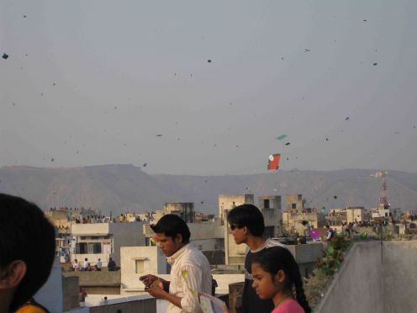
Fly Kites

Slide 8
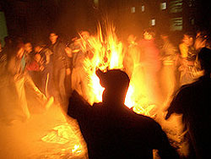
Bhogi (Andhra Pradesh)
Lohri (Punjab)

Slide 9
People take bath in the sacred river, Ganges, and pray to Sun God

Slide 10
Eat Til-Gul Ladoos

Slide 11
Eat Pongal

